Slide 1
Murach’s C# (8th Edition)
Chapter 15
How to work with interfaces and generics

Slide 2
Objectives
Applied
Use .NET interfaces as you develop the classes for an app.
Develop and use your own interfaces.
Knowledge
Distinguish between an interface and an abstract class.
Describe the use of the .NET ICloneable, IComparable<T>, and IEnumerable<T> interfaces.
In general terms, describe the use of default methods as well as static fields and methods in interfaces.
In general terms, describe the use of generic interfaces.

Slide 3
A Product class that implements the IDisplayable interface
public class Product : IDisplayable
{
public Product() { }
public Product(string code, string description,
decimal price) =>
(Code, Description, Price) = (code, description, price);
public string Code { get; set; } = "";
public string Description { get; set; } = "";
public decimal Price { get; set; }
public string GetDisplayText(string sep) =>
$"{Code}{sep}{Description}{sep}{Price.ToString("c")}";
}

Slide 4
Code that uses the IDisplayable interface
IDisplayable product =
new Product("C#", "Murach's C#", 59.50m);
Debug.WriteLine(product.GetDisplayText("\n"));

Slide 5
A comparison of interfaces and abstract classes
Both interfaces and abstract classes can provide signatures for properties and methods that a class must implement.
Both interfaces and abstract classes can implement some or all of their properties and methods.
An abstract class can use instance variables and constants as well as static variables and constants.
An interface can only use static variables and constants.
A class can inherit only one class (including abstract classes), but a class can implement more than one interface.

Slide 6
An interface that defines one method
public interface IDisplayable
{
string GetDisplayText(string sep);
}

Slide 7
An interface that defines two methods and a property
public interface IPersistable
{
object Read(string id);
bool Save(object o);
bool HasChanges { get; set; }
}

Slide 8
An interface that inherits two interfaces
public interface IDataAccessObject :
IDisplayable, IPersistable
{
// add additional members here
}

Slide 9
An interface that defines a default method
public interface IDisplayable
{ string GetDisplayText(string sep) => ToString() + sep; }

Slide 10
A class that uses the default method
public class Product : IDisplayable
{
// This doesn't override the GetDisplayText() method.
// It uses the GetDisplayText() method defined
// by the interface.
}

Slide 11
A class that overrides the default method
public class Product : IDisplayable
{
...
public string GetDisplayText(string sep) =>
$"{Code}{sep}{Description}{sep}{Price.ToString("c")}";
}

Slide 12
An interface that defines a static method and a static field
public interface IPrintable
{
static string terminator = "\r\n";
static string Print(IDisplayable d) =>
d.GetDisplayText(terminator);
}

Slide 13
Code that calls a static method from an interface
IDisplayable product =
new Product("C#", "Murach's C#", 59.50m);
string printString = IPrintable.Print(product);

Slide 14
Code that implements interfaces
A Product class that implements ICloneable
public class Product : ICloneable
A Product class that implements two interfaces
public class Product : ICloneable, IDisplayable

Slide 15
A class that inherits a class and implements two interfaces
public class Book : Product, ICloneable, IDisplayable

Slide 16
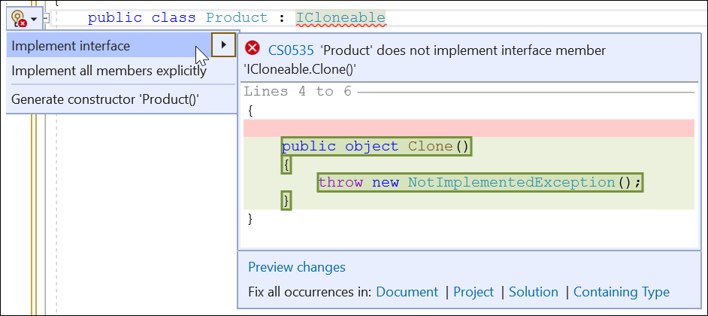
The Quick Actions menu for an interface name

Slide 17
The code that’s generated when you implement the interface
public object Clone()
{
throw new NotImplementedException();
}

Slide 18
The code that’s generated when you explicitly implement the interface
object ICloneable.Clone()
{
throw new NotImplementedException();
}

Slide 19
The code for the cloneable Product class
public class Product : IDisplayable, ICloneable
{
public Product() { }
public Product(string code, string description,
decimal price) =>
(Code, Description, Price) = (code, description, price);
public string Code { get; set; } = "";
public string Description { get; set; } = "";
public decimal Price { get; set; }
public string GetDisplayText(string sep) =>
$"{Code}{sep}{Description}{sep}{Price.ToString("c")}";
public object Clone() =>
new Product(Code, Description, Price);
}

Slide 20
Code that creates and clones a Product object
Product p1 = new("RDA", "Murach's R for Data Analysis",
59.50m);
Product p2 = (Product)p1.Clone();
p2.Code = "PDA";
p2.Description = "Murach's Python for Data Analysis";
Debug.WriteLine(p1.GetDisplayText("\n") + "\n");
Debug.WriteLine(p2.GetDisplayText("\n") + "\n");
The output that’s displayed
RDA
Murach's R for Data Analysis
$59.50
PDA
Murach's Python for Data Analysis
$59.50

Slide 21
A CreateList() method that uses an interface as a parameter
public static List<object> CreateList(ICloneable obj,
int count)
{
List<object> objects = new();
for (int i = 0; i < count; i++)
{
object o = obj.Clone();
objects.Add(o);
}
return objects;
}

Slide 22
A WriteToDebug() method that uses an interface as a parameter
public static void WriteToDebug(IDisplayable d) =>
Debug.WriteLine(d.GetDisplayText("\n") + "\n");

Slide 23
Code that uses the CreateList and WriteToDebug methods
Product product = new("C#", "Murach's C#", 59.50m);
List<object> products = CreateList(product, 3);
foreach (Product p in products)
{
WriteToDebug(p);
}
The output that’s displayed
C#
Murach's C#
$59.50
C#
Murach's C#
$59.50
C#
Murach's C#
$59.50

Slide 24
A CustomList<T> class that uses generics
public class CustomList<T>
{
private List<T> list = new();
// an Add() method
public void Add(T item) => list.Add(item);
// a read-only indexer
public T this[int i] => list[i];
// a read-only property
public int Count => list.Count;
// the ToString() method
public override string ToString()
{
string listString = "";
foreach (T item in list)
{
listString += item?.ToString() + "\n";
}
return listString;
}
}

Slide 25
Code that uses the CustomList<T> class (Test 1)
Debug.WriteLine("List 1 - ints");
CustomList<int> list1 = new();
int int1 = 11;
int int2 = 7;
list1.Add(int1);
list1.Add(int2);
Debug.WriteLine(list1.ToString());
Output from Test 1
List 1 - ints
11
7

Slide 26
Code that uses the CustomList<T> class (Test 2)
Debug.WriteLine("List 2 - Products");
CustomList<Product> list2 = new();
Product p1 = new("JAVA", "Murach's Java Programming",
59.50m);
Product p2 = new("C#", "Murach's C#", 59.50m);
list2.Add(p1);
list2.Add(p2);
Debug.Write(list2.ToString());
Output from Test 2
List 2 - Products
JAVA Murach's Java Programming $59.50
C# Murach's C# $59.50

Slide 27
A class that implements the IComparable<T> interface
public class Product : IComparable<Product>
{
public string Code { get; set; } = "";
public string Description { get; set; } = "";
public decimal Price { get; set; }
// other members
public int CompareTo(Product? other) =>
this.Code.CompareTo(other?.Code);
}

Slide 28
Code that uses the class
Product p1 = new("JAVA", "Murach's Java Programming",
59.50m);
Product p2 = new("C#", "Murach's C#", 59.50m);
int compareValue = p1.CompareTo(p2);
if (compareValue > 0)
Debug.WriteLine("p1 is greater than p2");
else if (compareValue < 0)
Debug.WriteLine("p1 is less than p2");
else if (compareValue == 0)
Debug.WriteLine("p1 is equal to p2");

Slide 29
Values that can be returned by the CompareTo() method
-1, 0, 1

Slide 30
A class that uses constraints
public class CustomList<T> where T: class, IComparable<T>
{
private List<T> list = new();
// an Add() method that keeps the list sorted
public void Add(T newitem)
{
for (int i = 0; i < list.Count; i++)
{
var item = list[i];
int compare = newitem.CompareTo(item);
if (compare <= 0) // new item less than or
{ // equal to current item
list.Insert(i, newitem);
return;
}
}
list.Add(newitem);
}
...
}

Slide 31
Keywords that can be used to define constraints
class
struct
new()
System.Enum
System.Delegate

Slide 32
A class that’s constrained to value types
public class StructList<T> where T: struct
Another class that uses constraints
public class ProductList<T> where T: Product,
IComparable<T>, new()

Slide 33
A class that implements IEnumerable<T>
public class CustomList<T> : IEnumerable<T>
{
private List<T> list = new();
// other members
public IEnumerator<T> GetEnumerator()
{
foreach (T item in list)
{
yield return item;
}
}
System.Collections.IEnumerator
System.Collections.IEnumerable.GetEnumerator()
{
throw new NotImplementedException();
}
}

Slide 34
Code that uses the CustomList class
Product p1 = new("JAVA", "Murach's Java Programming",
59.50m);
Product p2 = new("C#", "Murach's C#", 59.50m);
CustomList<Product> list = new();
list.Add(p1);
list.Add(p2);
foreach (Product p in list)
{
Debug.WriteLine(p.ToString());
}

Slide 35
An interface named IPersistable<T> that uses generics
public interface IPersistable<T>
{
T Read(string id);
bool Save(T obj);
bool HasChanges { get; set; }
}

Slide 36
A class that implements IPersistable<T>
public class Customer : IPersistable<Customer>
{
// other members
public bool HasChanges {
get => throw new NotImplementedException();
set => throw new NotImplementedException();
}
public Customer Read(string id)
{
throw new NotImplementedException();
}
public bool Save(Customer obj)
{
throw new NotImplementedException();
}
}

